Slide 1
Improvements of Product Management API Project

Slide 2
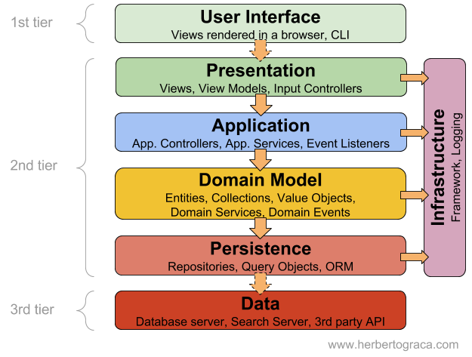
Layered Architecture

Slide 3
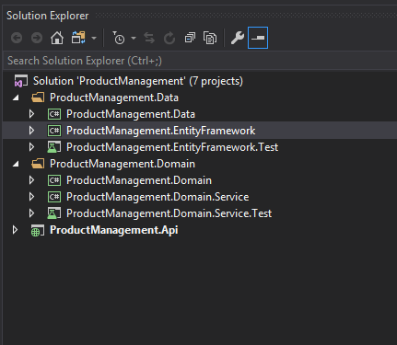

Slide 4
ProductManagement.Data Layer
ProductManagement.Data : Repositories and DataModels
ProductManagement.EntityFramework : Entity Framework to communicate with backend
ProductManagement.EntityFramework : Test repository classes

Slide 5
ProductManagement.Domain
ProductManagement.Domain : Domain Models and Interfaces
ProductManagement.Domain.Service : Business Logics and Service
ProductManagement.Domain.Service.Test : Test business logics using MOQ Test

Slide 6
Repository Pattern and Unit Of Work with Entity Framework
Test all the repositories using MSTest to ensure backend is working fine
Introduced Foreign Key to tables which was missing
Dependency Injection – Unity
No – SQL Injection

Slide 7
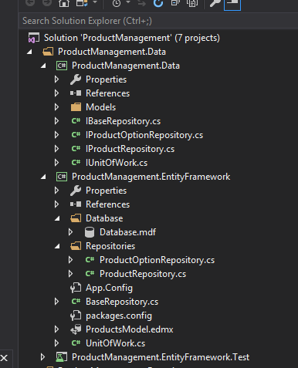

Slide 8
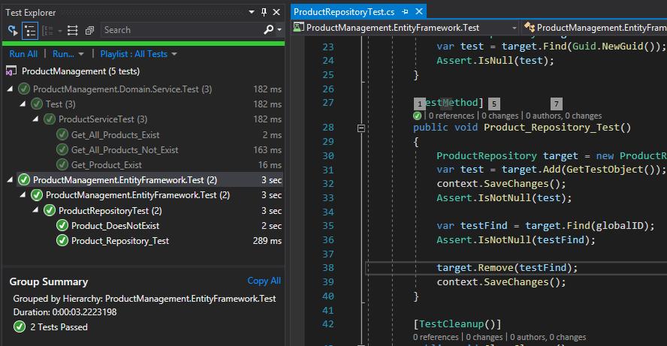
Unit Test - Repositories

Slide 9
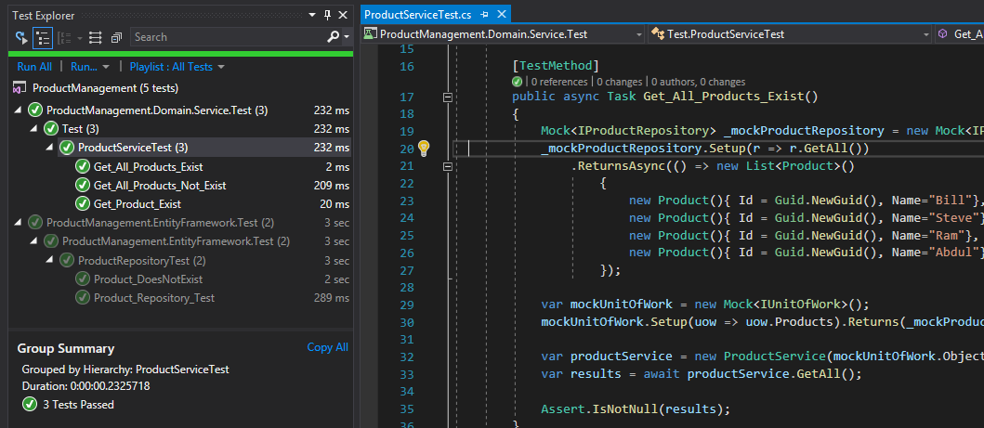
MOQ Testing for Business Logic

Slide 10
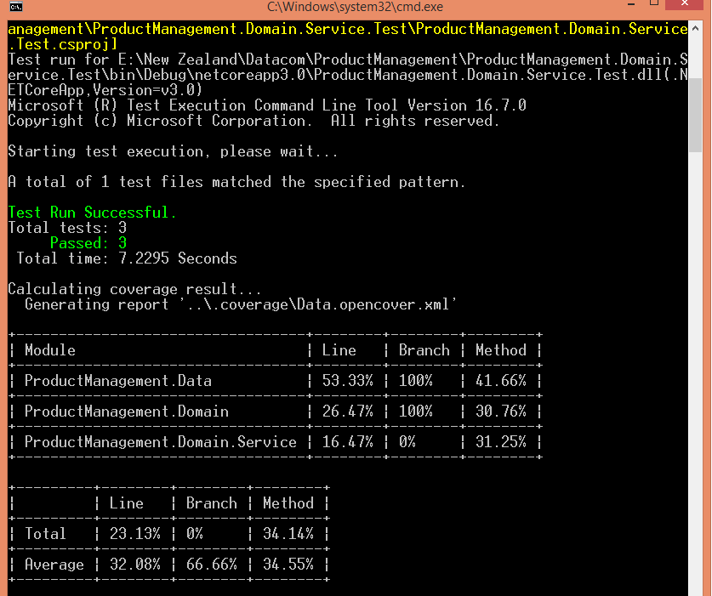
100% Code Coverage

Slide 11
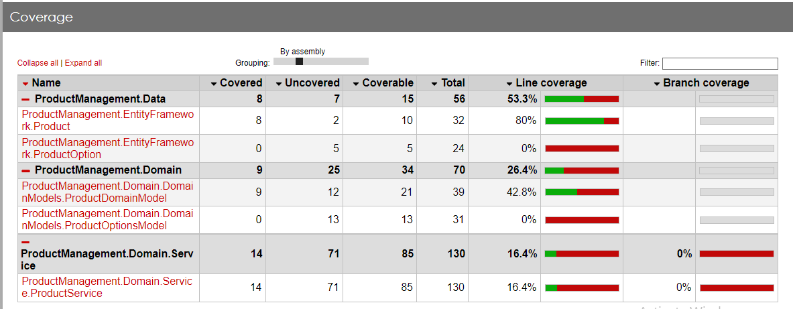
Report – Code Coverage

Slide 12
Web API
Async and Await Actions – More responsive
Exception Handling
Logger – For Logging information/errors
Swagger – For documentation
Attribute Routing / Attribute Validation

Slide 13
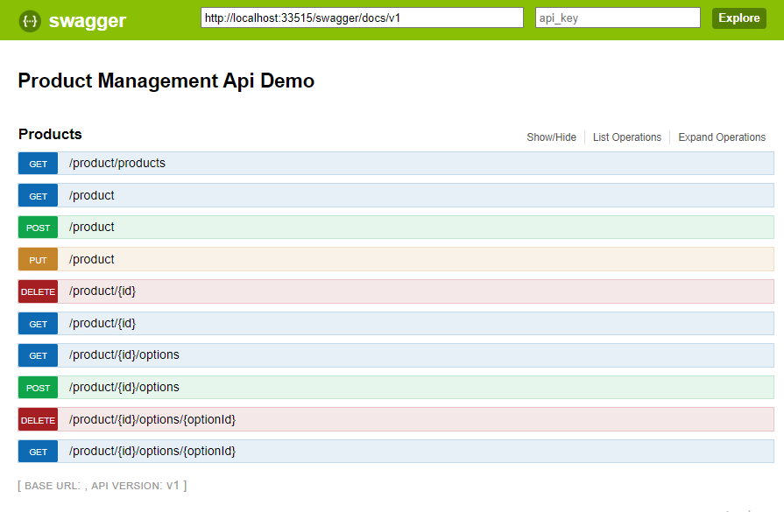

Slide 14
What’s Next ?
.Net Core + Entity Framework Core
Docker with Cloud Platform
Security – OWIN/ OAuth / JWT Token

